Slide 1
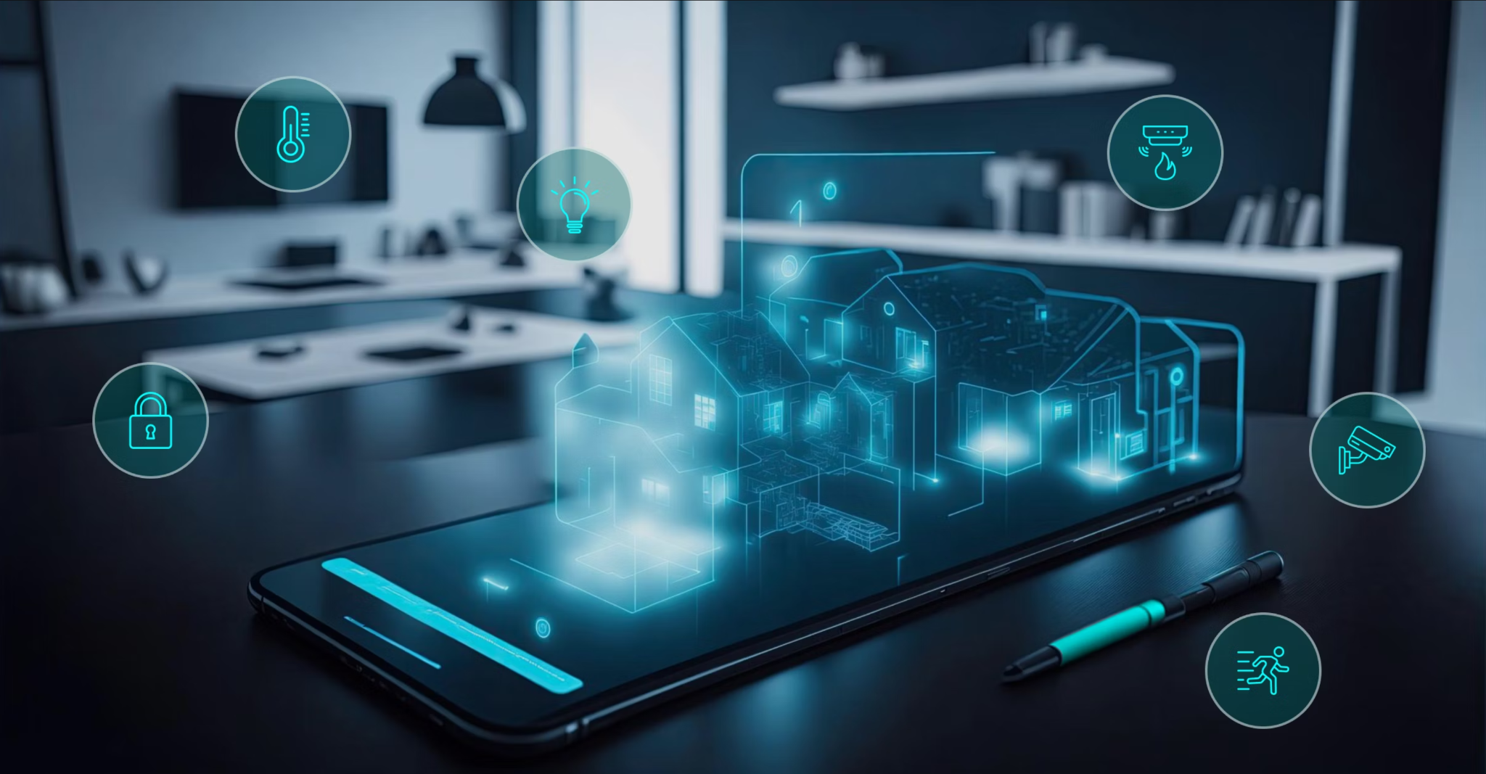

Team 61: Smart Home Automation
Bi-Weekly Update 5 Nick Tool, Tyler Mayou, Matthew McLean Sponsor: Souryendu Das TA: Fahrettin Ay
Notes:
Michelle

Slide 2
Project Summary
The Problem: “Smart home systems are often composed of many different components from different companies. This can make it very difficult for a user to combine devices and implement a fully functional system for their own personal living or working space.”
Our Goal: “Develop a basic smart home automation system that allows users to control a few essential home appliances (like lights and speakers) via a mobile app and a simple web interface. The system will use non-IoT devices and a local server and online database.”
Notes:
Kyle

Slide 3
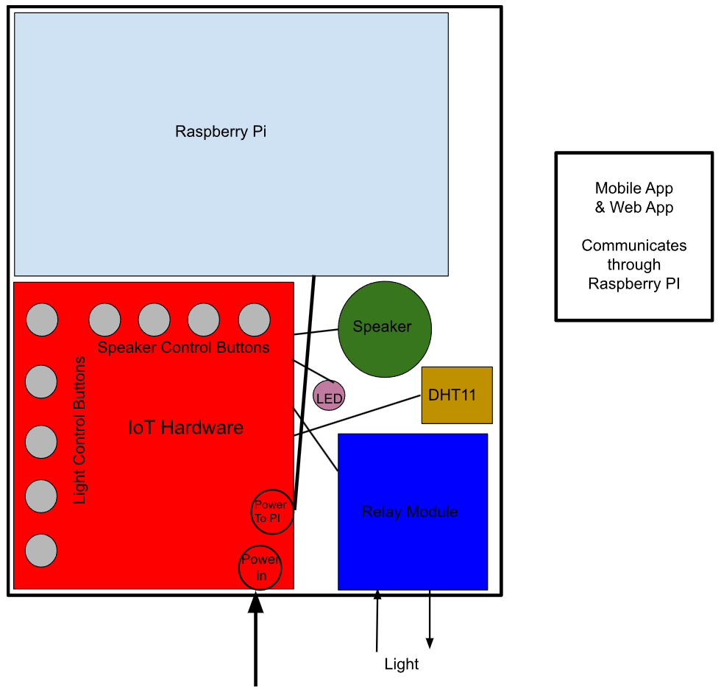
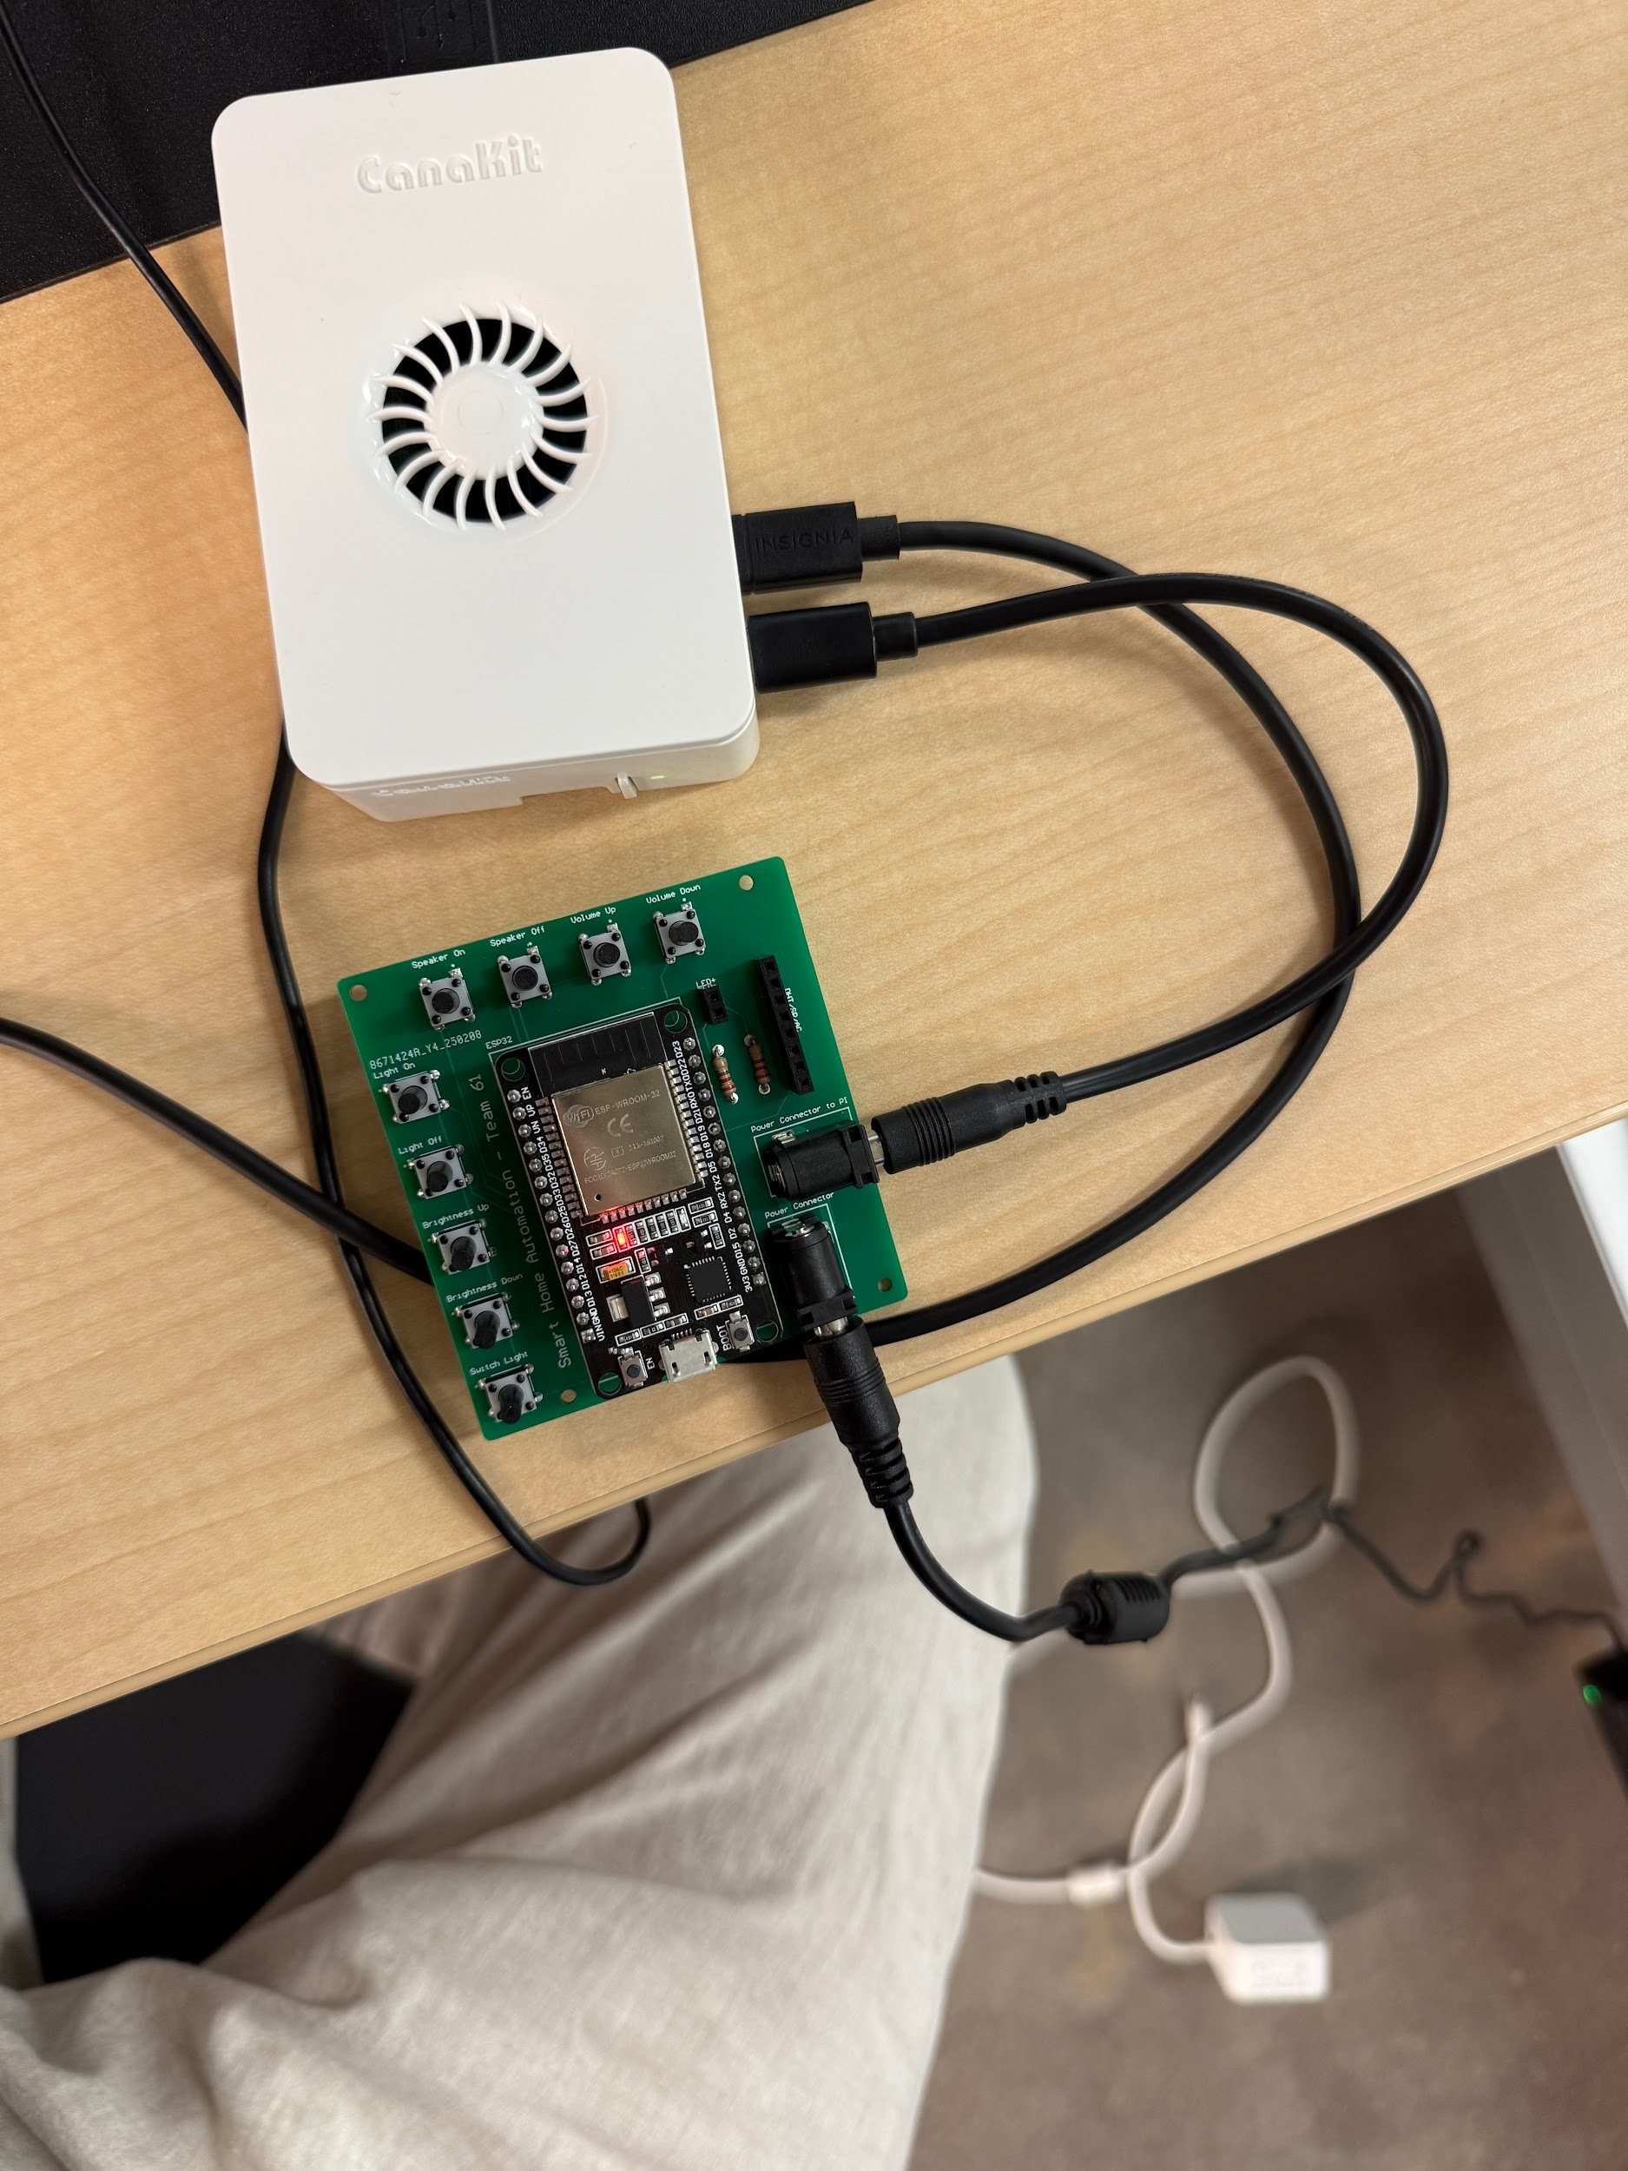
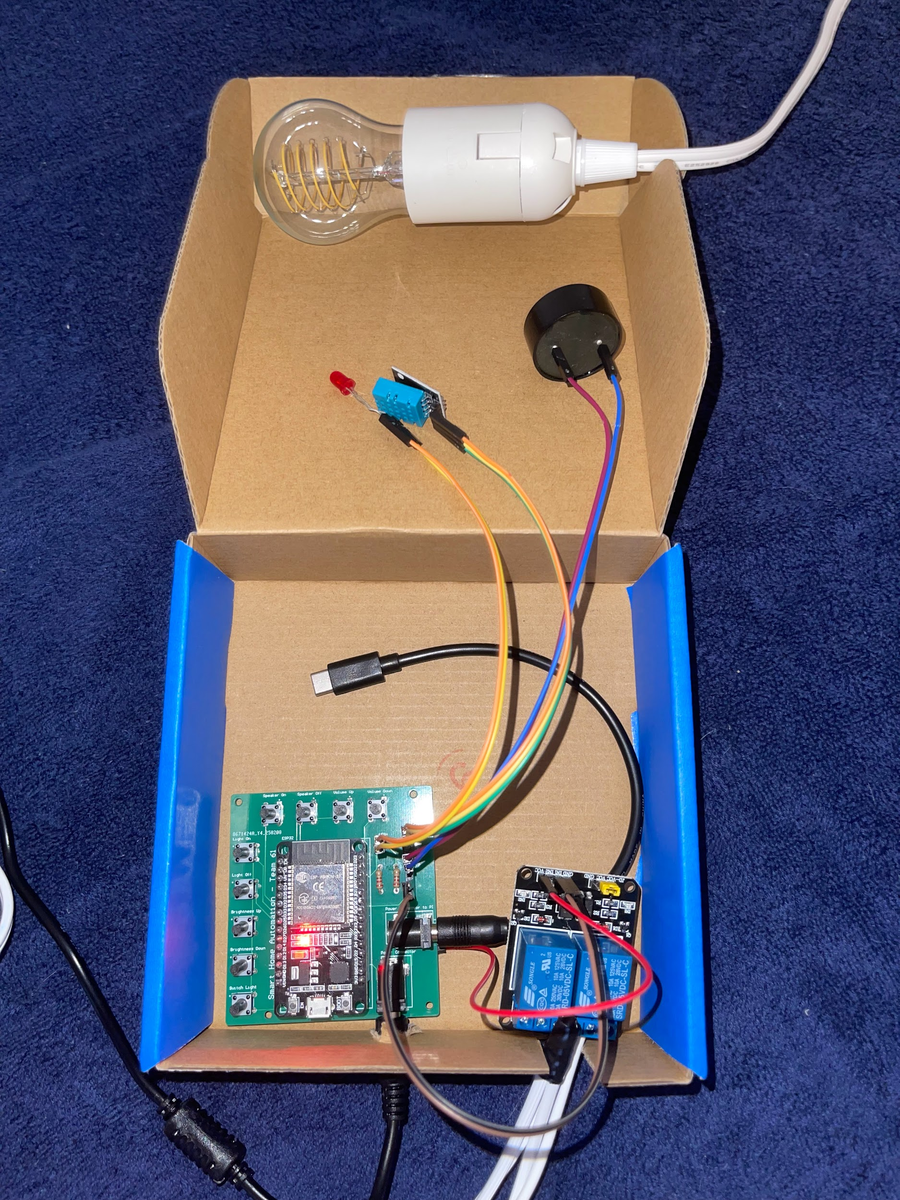
Integrated System Diagram
IoT Hardware and Raspberry PI communicate using MQTT
Conceptual Design
Notes:
Eric

Slide 4
Project Timeline
Green done, Yellow underway, White not started, Orange behind
Subsystem Designs and Testing (to complete 2/10) | Integration of App and Website (to complete 2/24) | Integration of IoT Hardware (to complete by 3/26) | Final Integration (to complete by 4/2) | System Test (to complete by 4/9) | Validation (to complete by 4/16) | Demo and Report (to complete by 4/21)
Notes:
Eric

Slide 5
Mobile and Web App Integration
Matthew McLean
Accomplishments since last update 20 hrs of effort | Ongoing progress/problems and plans until the next presentation
The mobile app was connected to the server and database login functionality tested and verified on both ends for mobile app Usage statistics plot added on app settings updated to display current username and devices. Username properly displays, but devices failed to display | Work on email authentication was in progress during testing for mobile app connectivity. Sign up tests delayed Finish integrating the rest of the mobile app Fix issue with devices not showing up

Slide 6
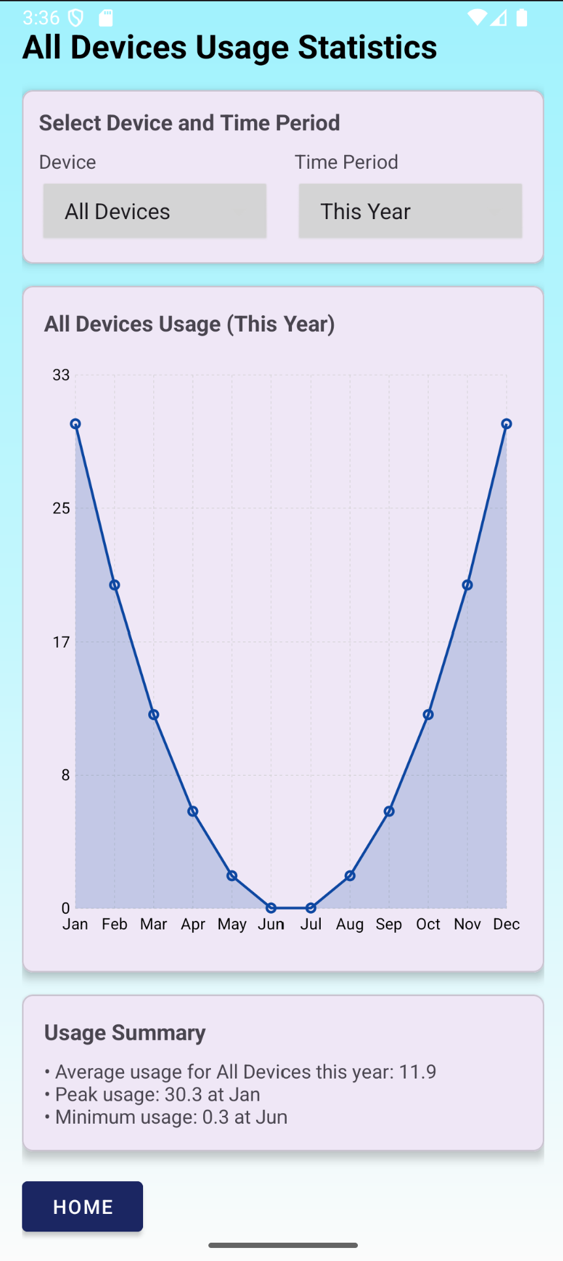
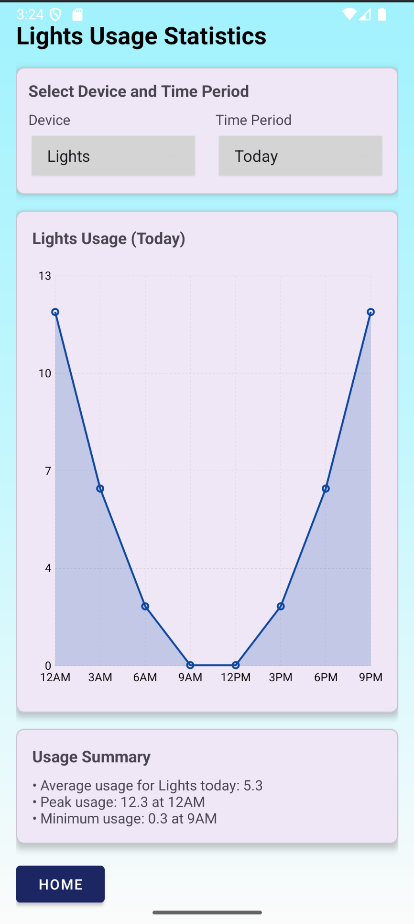
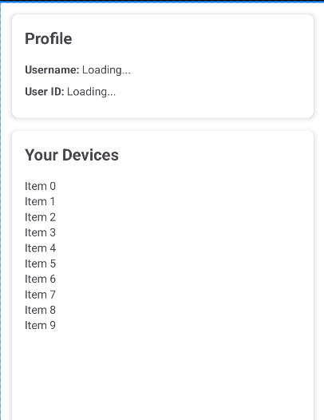
Mobile App Integration
Matthew McLean

Slide 7
Hardware Integration
Tyler Mayou
Accomplishments since last update 17 hrs of effort | Ongoing progress/problems and plans until the next presentation
Issues with the TAMU_IoT WiFi ESP32 connects to WiFi ESP32 able to perform HTTP GET and POST requests | SW integration for ESP32 with Back-end using HTTP instead of MQTT Validation of communication and control of devices

Slide 8
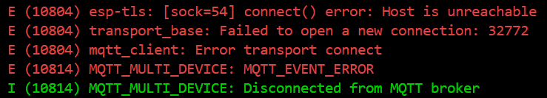
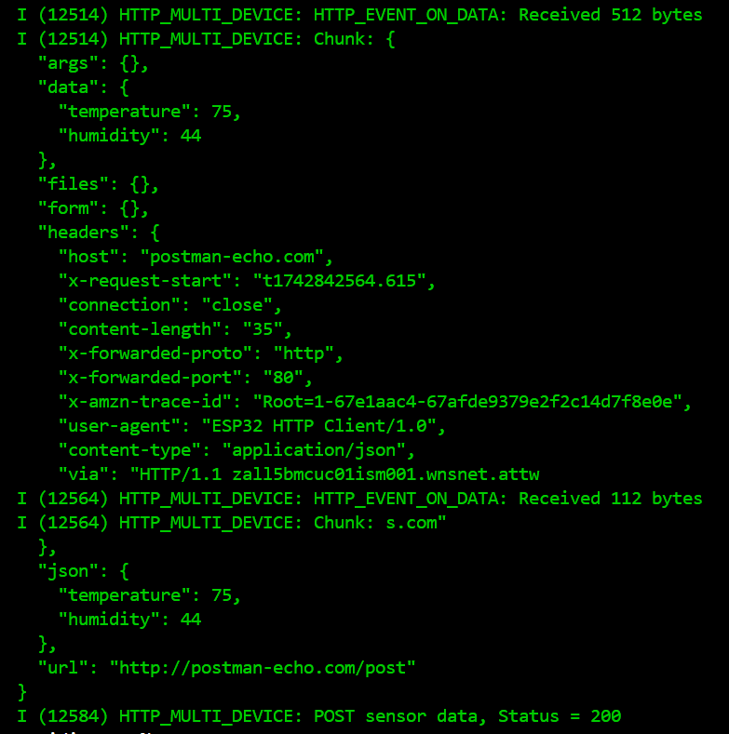
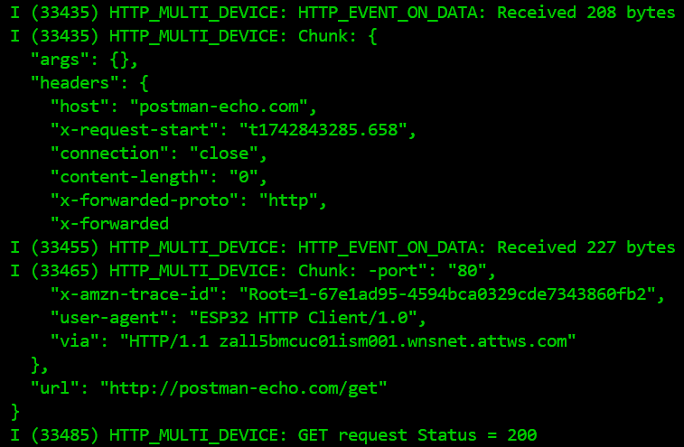
Hardware Integration

Slide 9
Backend Server Integration
Accomplishments since last update 14 hrs of effort | Ongoing progress/problems and plans until the next presentation
Validated session permissions Validated email verification Integrated mobile application with backend server and database | Integrate with Hardware now that WiFi issue has been solved Continue validating realistic scenarios for frontend and backend interaction

Slide 10
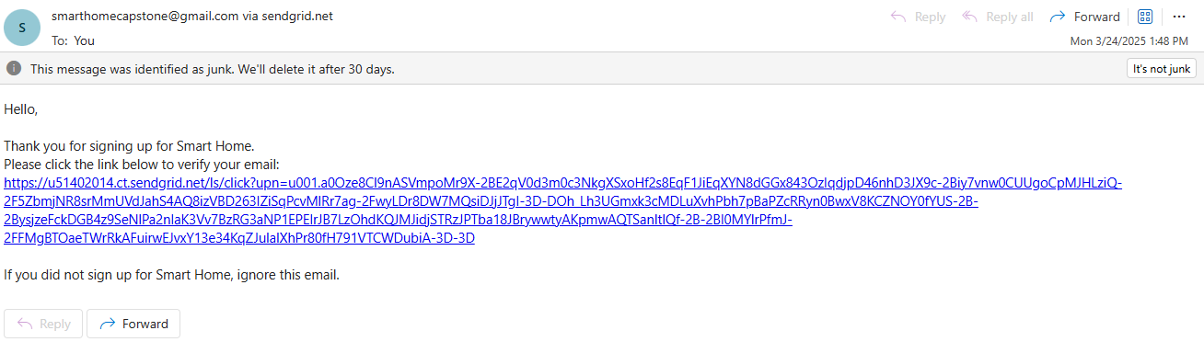
Backend Server Integration

Slide 11
Execution Plan
 | 1/20 | 1/27 | 2/3 | 2/10 | 2/17 | 2/24 | 3/3 | 3/10 | 3/17 | 3/24 | 3/31 | 4/7 | 4/14 | 4/21 | 4/28 | Legend
Matthew McLean |  |  |  |  |  |  |  |  |  |  |  |  |  |  |  | Finished
Update Layout Of Website |  |  |  |  |  |  |  |  |  |  |  |  |  |  |  | Working on it
Integrate System with Host Server |  |  |  |  |  |  |  |  |  |  |  |  |  |  |  | Haven’t Started
Integrate Entire System
Nick Tool
Implement Public IP address
Implement Security Features
Integrate Host System with Mobile App and Website
Integrate Host System with IoT Hardware
Validate App & Website Integration
Validate IoT Hardware Integration
Test and Validate Basic Functions in Fully Integrated System
Test Edge Cases in Fully Integrated System
Tyler Mayou
Discuss 404 modifications
Order parts for modification
Order NEW PCB
Hardware integration
Team
Update #2
Update #3
Update #4
Update #5
Final Presentation
Final Demo
Final Report
Integration
System Test
Validation
Notes:
Michelle

Slide 12
SYSTEM Validation Plan
Test Name | Success Criteria | Methodology | Status | Owner
Power to hardware and Raspberry PI | Hardware board/components and Raspberry PI are powered at rated limits (PI - 5V 5A, Hardware - 5V 1A). PI is hosting server. All components through ESP32 are functional. | Plug in all components, Check if PI is hosting website, check if device components are functional. | TESTED | Tyler Mayou, Nick Tool
Communication between Raspberry PI and ESP32 | Both Raspberry PI and ESP32 can send and receive data through HTTP communication (Button presses from either side, Sensor Data). | First Establish connection between Raspberry PI and ESP32. Test if button presses are sent and received both ways. Test if sensor data can be sent/received. Lights/speaker are controllable from button press. | UNTESTED | Tyler Mayou, Nick Tool
Sign Up Functionality | User can create a new unique user in system and database reflects parameters. | Try to create a new user from the public website, check the database to make sure information matches sign up. | TESTED | Nick Tool, Matthew Mclean
Login Functionality | User can login to system, user stays logged in when navigating to different pages. | User will log in using created credentials, navigate to different pages, including settings, where the correct username should appear. | TESTED | Nick Tool, Matthew Mclean
Add and Delete Devices | User can add new devices to the system and delete devices from the system, while database reflects these changes. | On the settings page, add a new device while being logged in, check database to make sure that new device was added. | TESTED | Nick Tool, Matthew Mclean
Toggle Specific Device Status | User can select a specific device, and update its status or a specific parameter (Brightness, Volume, Temperature) | On any of the device pages, user will select a specific device, make a change to its status, and changes show up in the database and hardware status will change | PARTIALLY TESTED | Nick Tool, Matthew Mclean, Tyler Mayou
Notes:
Michelle

Slide 13
Thanks and Gig ‘em

